Slide 1
Working with Directives

Slide 2
JSP Directive
The directives of JSP are used to provide some meaningful information about the current JSP page to the JSP Container which will be required during the Translation phase.

Slide 3

Module Overview
@page Directive
@include Directive @taglib Directive

Slide 5
@page Directive

Slide 6
@page Directive
provides a means for setting attributes that affect how the page is interpreted and executed

Slide 7
<% page attribute="value" attribute="value"..%>
Syntax
Defining a page directive

Slide 8
Page Directive
language="scripting language"
extends="className" import="importList" session="true|false" buffer="none="none|sizekb" autoFlush="true|false" info="info_text" contentType="ctinfo" errorPage="error_url" isErrorpage="true|false"
Attributes

Slide 9
<%@page language="java"%>
<%@page language="java" import="java.io.x"%>
<%@page import="java.sql.*"%>

Slide 10
Page Directive Attributes
Language
<%@page language="java"%>
Import
<%@page import=“java.sql.*”,
import=“java.util.*”%>
Info
<%@page info="This is the home page for the web site"%>
Extends
<%@page extends="com.mycompany.demos"%>
ContentType
<%@page contentType="text/ht ml"%>
isElgnored
<%@page isElgnored="true"%>

Slide 11
Page Directive Attributes
isThreadSafe
<%@page isThreadSafe="false"%
>
pageEncoding
<%@page pageEncoding="UTF- 8"%>
Session
<%@page session="false"%>
autoFlush
<%@page autoFlush="true|false“
%>
Buffer
<%@page buffer="10kb"%>

Slide 12

Assisted Practice
@page Directive

Slide 14
@include Directive

Slide 15
Include Directive
will specify the JSP Container to read the specified file and merges its contents into the JSP source code currently being parsed at the Translation phase

Slide 16
<%@ include file="filename"%>
<%@ include file="header.jsp"%>
Syntax
Inorder to use the include directive

Slide 18
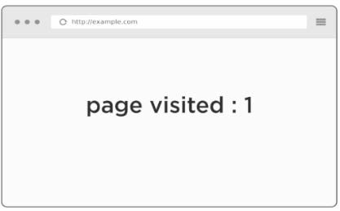
main.jsp
codesnippet.jsp
<%@ include file="codesnippet.jsp" %>
<p>page visited : <%= accessCount++; %> </p>
<% int accessCount=0; %>

Slide 19
Assisted Practice
@include Directive

Slide 20
@taglib Directive

Slide 21
Set of custom tags
Identifies the location of the library Identifying the custom tags
@taglib Directives

Slide 22
<% @taglib uri="uriofTagLibrary" prefix="prefixOfTag"/%>
<% jsp:directive.taglib uri="uri" prefix="prefixOfTag"/%>
Syntax
To Define the taglib directive

Slide 23
Summary
@page Directive
@include Directive @taglib Directive

